Slide 1

E-Commerce Data Analysis Project: Olist Market Insights
Strategic analysis using SQL, Excel, and Python to drive business decisions.
Prepared by: Mohamed Moussa

Slide 2
Project Overview
understanding sales dips
Extract and clean data from complex relational databases using SQL.
Identify top-performing cities by sales volume and order frequency.
Perform statistical analysis to determine order probabilities and market share.
Visualize product category performance in major hubs like Sao Paulo.

Slide 3

Phase 1
Monthly Sales Summary
Analyzing revenue growth and seasonal sales trajectories over time.

Slide 4
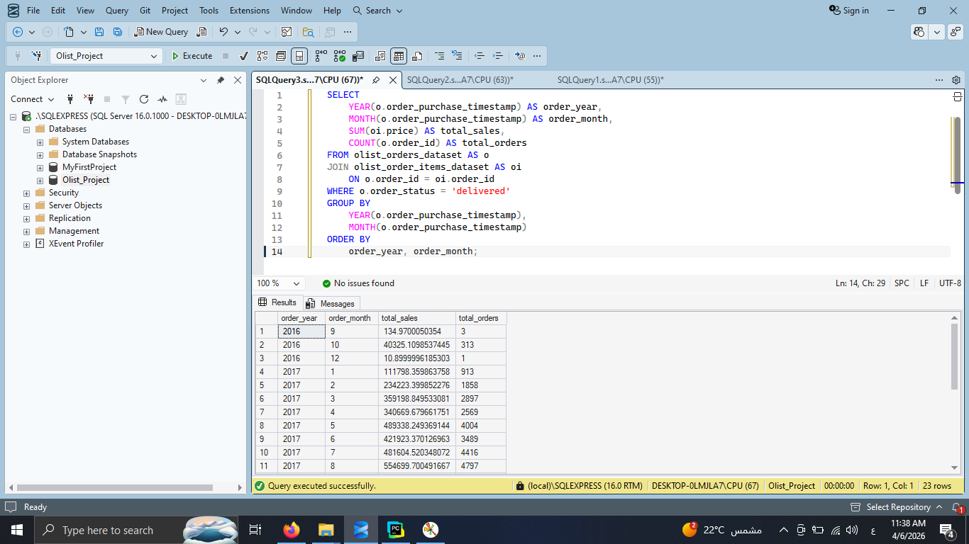
Step 1: SQL - Extracting Monthly Sales Trends
Aggregating revenue and order count by month
Extracted purchase dates and total price from 'olist_orders' and 'order_items’.
Grouped data by year and month to identify seasonal growth.
Filtered for 'delivered' status to ensure data accuracy.

Slide 5
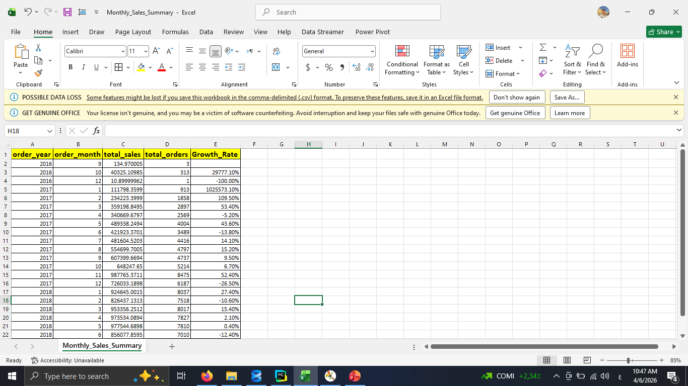
Step 2: Excel - Data Refinement & Calculations
Preparing the dataset for advanced visualization.
Handled missing values and date formatting issues.
Calculated Month-over-Month (MoM) growth rates.
Prepared a clean CSV file for Python integration.

Slide 6
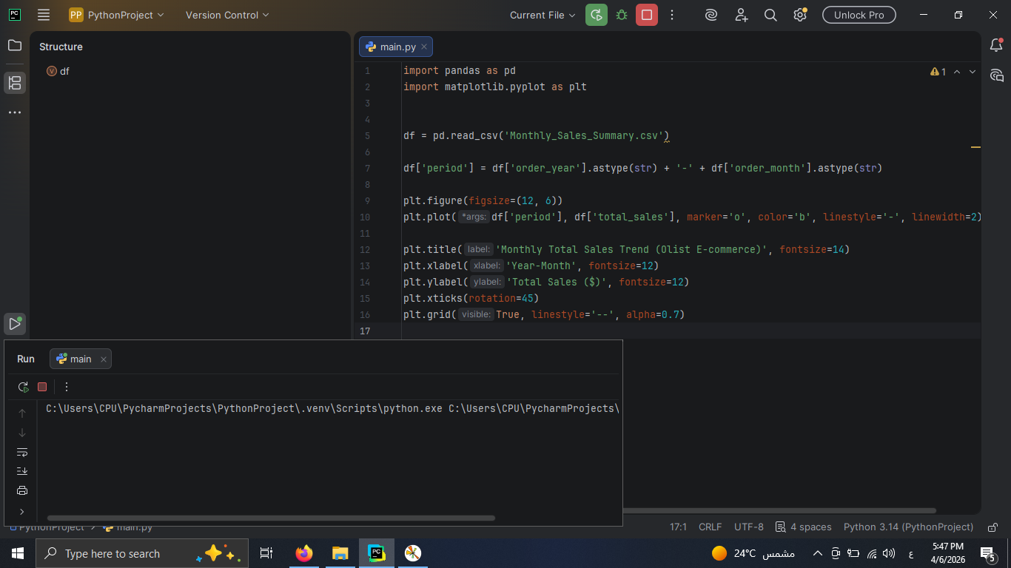
Step 3: Python - Automated Time-Series Plotting
Using Matplotlib to visualize the revenue trend.
Used Pandas to load the Excel-refined data and engineered a 'Period' column for chronological plotting.
Created a Line Plot to visualize the trajectory of sales over time.
Applied custom styling (Grid, Markers, Labels) for professional output.

Slide 7
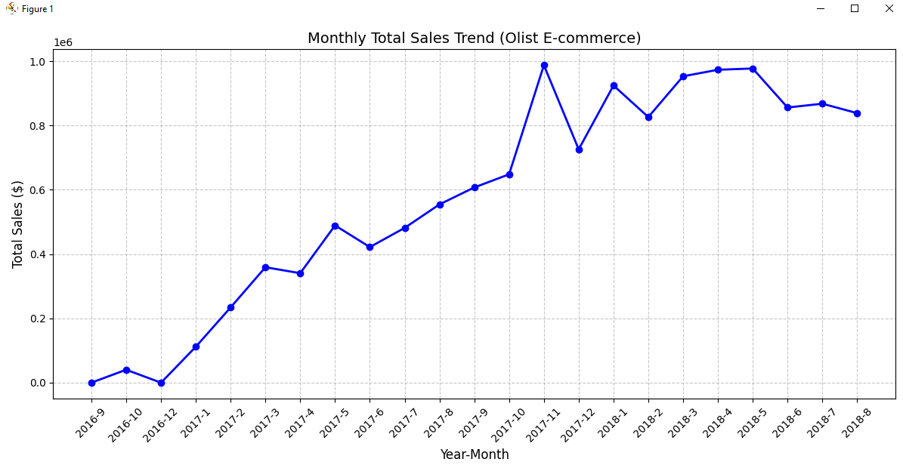
Step 4: Visualization - Monthly Sales Summary
Clear upward trajectory in revenue from 2017 to 2018.
Observation: The business experienced steady growth with significant spikes in late 2017.
Insight: The peak sales periods align with major Brazilian retail holidays.
Business Impact: This trend helps in forecasting inventory needs for the upcoming year.

Slide 8
Phase 2
Olist Top Cities Performance
Analyzing regional sales distribution and market dominance

Slide 9
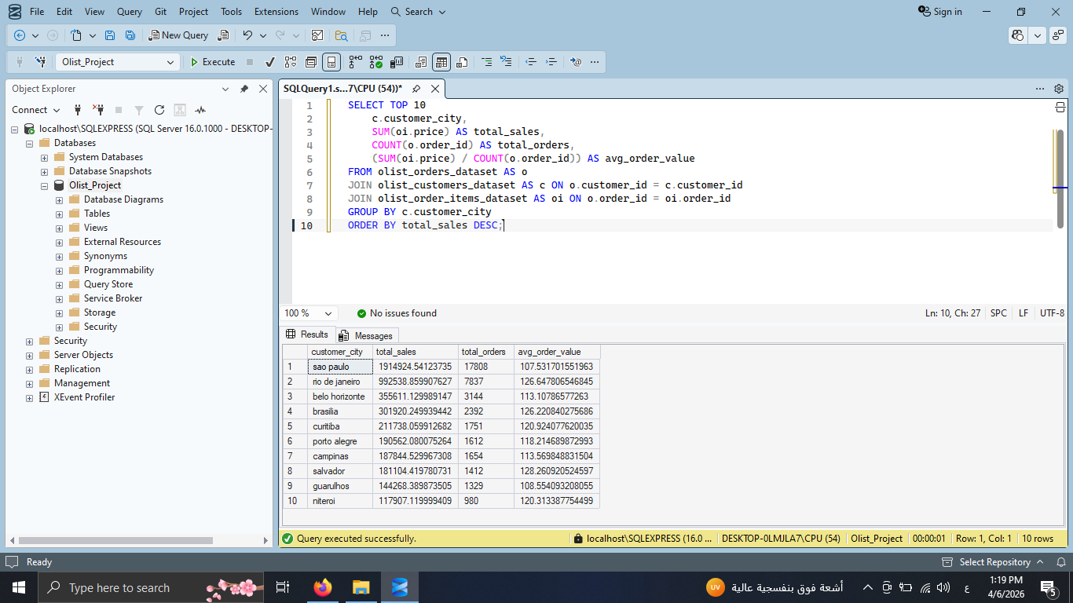
Step 1: SQL - Geographic Sales Performance
Identifying Top Revenue-Generating Cities
Joined 'Orders', 'Customers', and 'Items' tables to map sales to locations.
Aggregated total revenue, order volume, and Average Order Value (AOV) per city to identify profitability.
Filtered for the Top 10 cities to focus on high-impact markets.

Slide 10
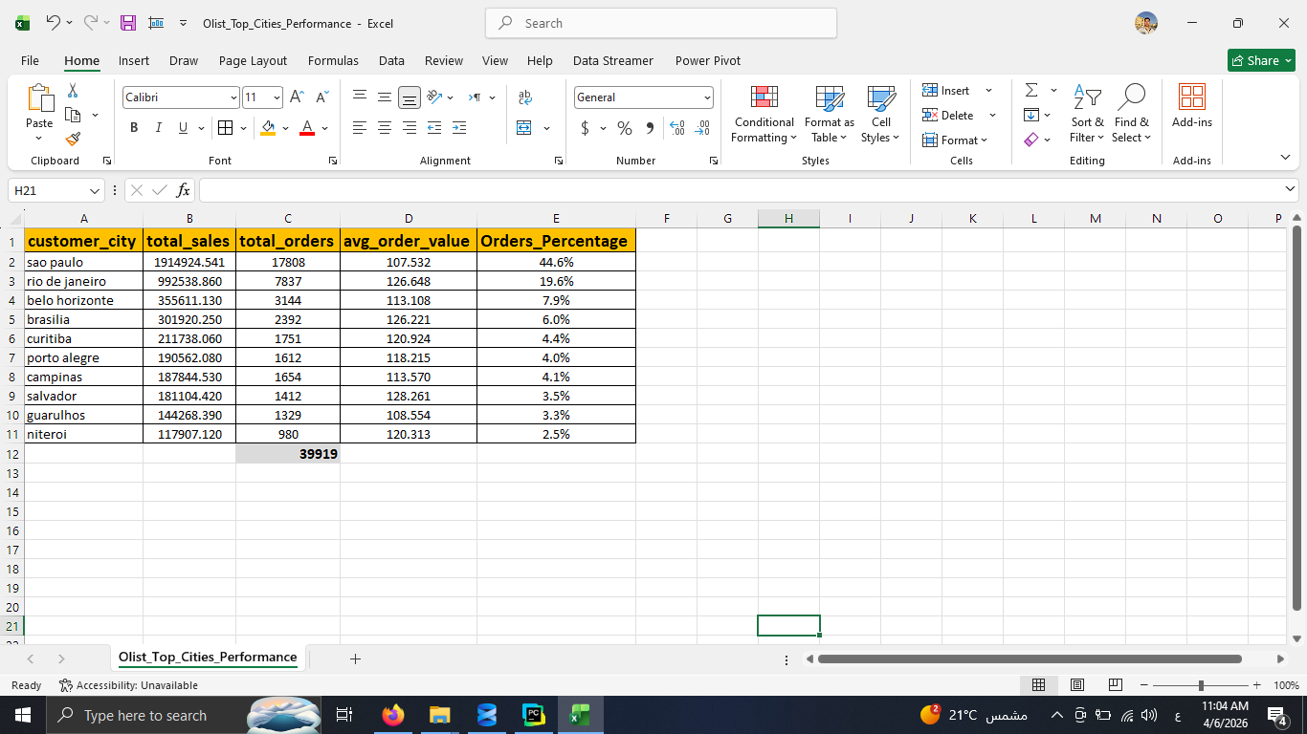
Step 2: Excel - Statistical Analysis: Market Share & Probability
Quantifying the dominance of major hubs.
Calculated the Market Share and Order Probability for each hub.
Analyzed the cumulative market share of the top 10 cities.
Validated data consistency before Python visualization.

Slide 11
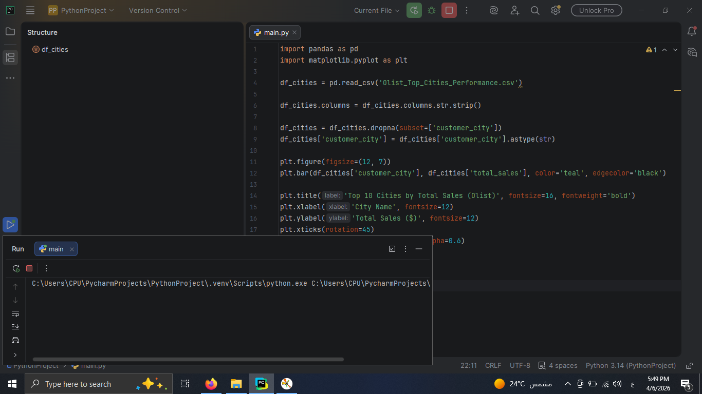
Step 3: Python Automation: Ranking Visualization
Creating a professional Bar Chart for executive reporting.
Handled data type conversion (Float to String) for city labels.
Customized aesthetics using 'Teal' color coding and grid formatting.
Automated the chart generation to allow for future dataset updates.

Slide 12
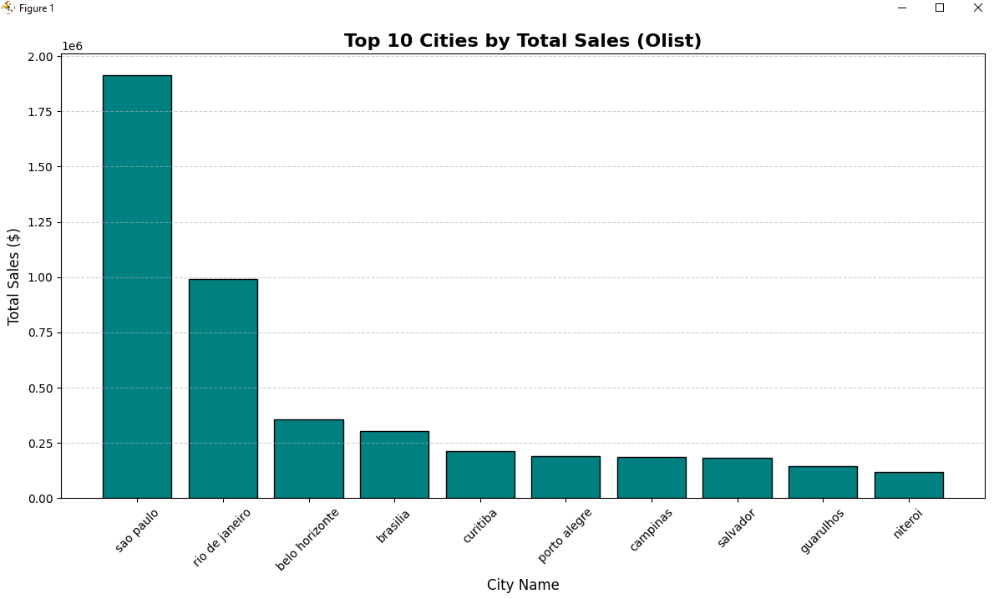
Step 4: Final Insight - Geographic Insight: The Dominance of Sao Paulo
A visual breakdown of regional sales performance.
Observation: Sao Paulo is the primary market driver, significantly outperforming Rio de Janeiro.
Market Insight: Over 40% of top-tier sales are concentrated in just the top 2 cities.
Strategic Recommendation: Optimize logistics and warehouse placement in Sao Paulo to reduce delivery times.

Slide 13
Phase 3
Sao Paulo Products Analysis
Identifying top-performing product categories and consumer niche demands.

Slide 14
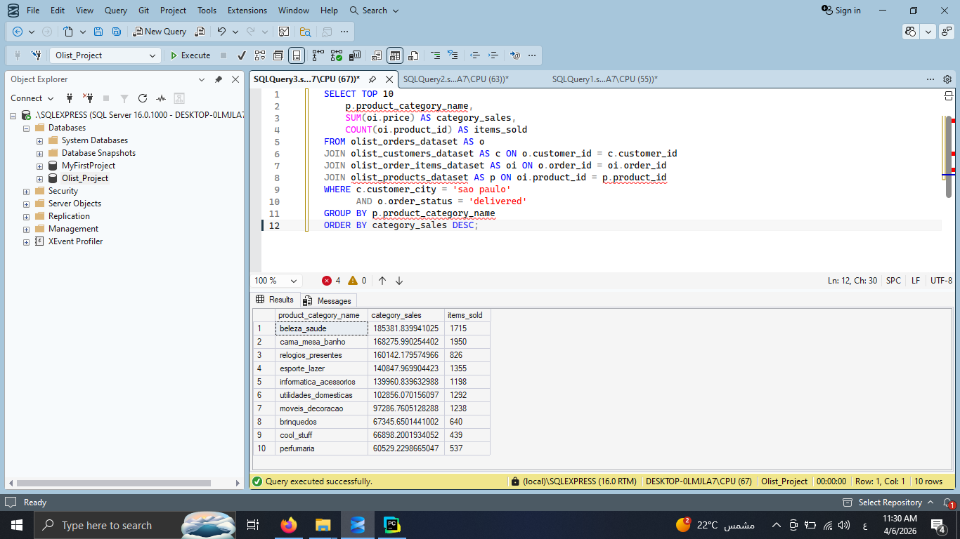
Step 1: SQL - Sao Paulo Product Category Analysis
Uncovering Demand in the Top-Performing Market
Executed a Multi-table Join (4 datasets) to correlate product categories with specific geographical customer data.
Applied multi-layered filtering to isolate delivered orders within the Sao Paulo market..
Aggregated sales volume and total revenue per product category.

Slide 15
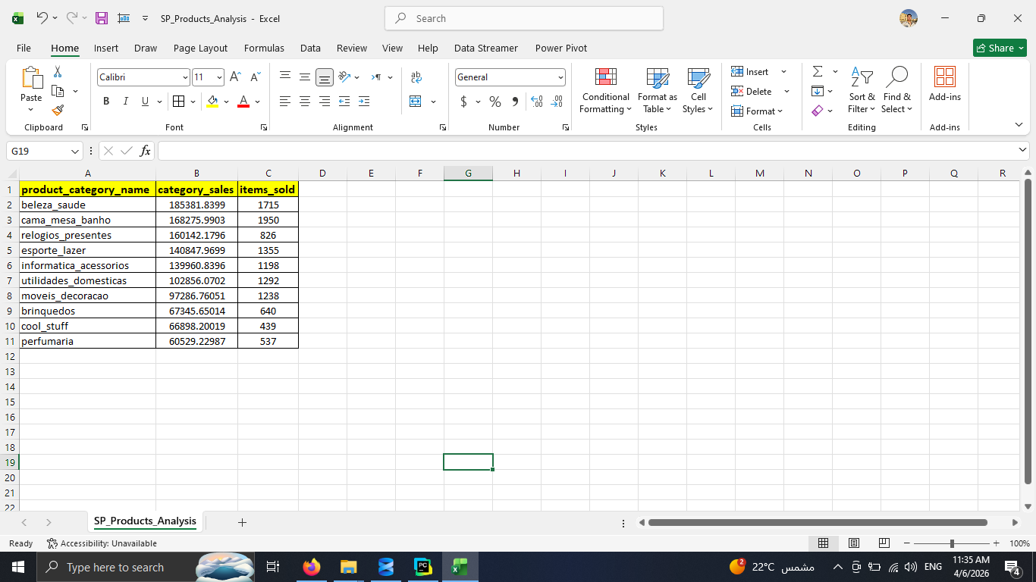
Step 2: Excel - Processing & Formatting Product Data
Preparing high-volume data for visualization
Mapped Portuguese category names to English for better reporting.
Identified the top 10 most popular categories by revenue contribution.
Exported the refined dataset for Python horizontal bar charting.

Slide 16
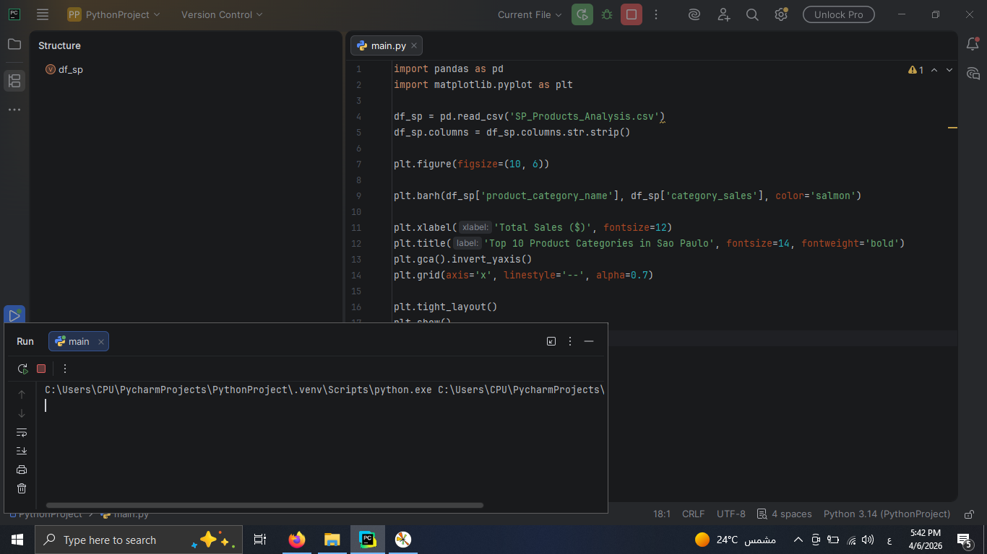
Step 3: Python - Visualizing High-Density Categories
Creating readable charts for long label names.
Implemented a Horizontal Bar Chart (barh) to ensure full category names are visible.
Applied a "Salmon" color theme to distinguish this phase from city-level analysis.
Sorted data in descending order and inverted the Y-axis for top-to-bottom ranking visibility

Slide 17
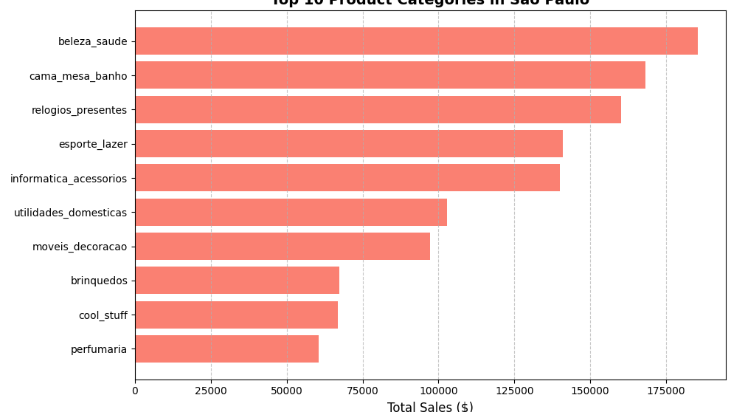
Step 4: Product Insights - Sao Paulo Market Demand
Identifying growth opportunities in specific niches.
Observation: Health & Beauty (Beleza Saude) and Bed & Bath Decor are the highest-grossing categories.
Consumer Insight: Sao Paulo's market is heavily driven by lifestyle and personal care products.
Final Recommendation: Run targeted promotion campaigns for "Personal Care" items to maximize ROI in this region.

Slide 18
Conclusion & Next Steps
Successfully integrated SQL, Excel, and Python for a full-cycle analysis.
Identified key markets and product winners to guide business strategy.
Ready for deployment or further predictive modeling.
Thank You!

